Slide 1

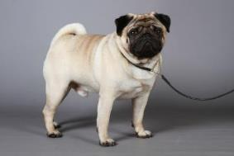
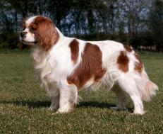
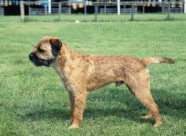
VetCompass: Unweaving the rainbow of canine health
Dr Dan O’Neill
MVB BSc(hons) GPCert(SAP) GPCert(FelP) GPCert(Derm) GPCert(B&PS) MSc(VetEpi) PhD MRCVS
Diane Pearce Collection / The Kennel Club ©
Diane Pearce Collection / The Kennel Club ©
Diane Pearce Collection / The Kennel Club ©
Breed Health Co-ordinator Symposium, Sept 23rd, 2016

Slide 2

Beauty vs Understanding
Beauty and Understanding
Science reveals, rather than destroys, the true beauty of the world

Slide 3
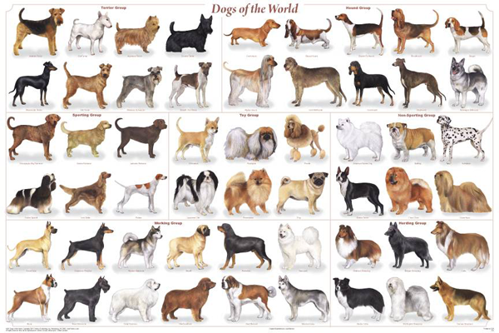
Science reveals, rather than destroys, the true beauty of the world
Kennel Club founded: 1873
Breeds recognised by the KC: 215

Slide 4
Journal of Small Animal Practice 1963
Hodgman, S. F. J. (1963) Abnormalities and defects in pedigree dogs–I. An investigation into the existence of abnormalities in pedigree dogs in the British Isles. Journal of Small Animal Practice 4, 447-456
Hein, H. E. (1963) Abnormalities and defects in pedigree dogs-II. Hereditary aspects of hip dysplasia. Journal of Small Animal Practice 4, 457-462
Knight, G. C. (1963) Abnormalities and defects in pedigree dogs–III. Tibio-femoral joint deformity and patella luxation. Journal of Small Animal Practice 4, 463-464
Barnett, K. C. (1963) Abnormalities and Defects in Pedigree Dogs–IV. Progressive Retinal Atrophy. Journal of Small Animal Practice 4, 465-467
Willis, M. B. (1963) Abnormalities and defects in pedigree dogs—V. Cryptorchidism. Journal of Small Animal Practice 4, 469-474
Do we know as much as we think we do???
Diane Pearce Collection / The Kennel Club ©
Diane Pearce Collection / The Kennel Club ©
Diane Pearce Collection / The Kennel Club ©

Slide 5

Dogs – do we really know as much as we think?
      A few simple questions:
        What are the 3 most common disorders of dogs?
        Is the prevalence of common disorders higher in purebred dogs than in crossbred dogs?
        What is the average lifespan of a dog?
        Do crossbred dogs live longer than purebred dogs?
        Do similarly-sized small dogs have the same top disorders?
Is our belief: Blind or Evidence-based?
What is the truth?

Slide 6

Epistemology
OED: The theory of knowledge, especially with regard to its methods, validity, and scope, and the distinction between justified belief and opinion.

Slide 7

Truth
OED: A fact or belief that is accepted as true.
Vs.
OED: That which is true or in accordance with fact or reality.

Slide 8

Reality
OED: The state of things as they actually exist, as opposed to an idealistic or notional idea of them.

Slide 9
How do we know what is real?
Five senses: sight, smell, touch, hearing, taste
Dinosaurs?
Stars?
Bacteria?
Radio waves?
DNA?
Aggression?
Five senses: sight, smell, touch, hearing, taste and science
Science gives us Evidence

Slide 10

Evidence
OED: The available body of facts or information indicating whether a belief or proposition is true or valid.
Key Message:
Base your Belief of the Truth on the Evidence

Slide 11
Companion animals – do we really know everything?
      A few simple questions:
        What are the 3 most common disorders of dogs?
        Is the prevalence of common disorders higher in purebred dogs than in crossbred dogs?
        What is the average lifespan of dogs?
        Do crossbred dogs live longer than purebred dogs?
        Do similarly-sized small dogs have the same top disorders?

Slide 12

Canine Health Evidence To Date
Questionnaires/surveys
Referral vet data
Insurance data
Laboratory/Experimental
Biased
Not representative
Out of date
Non-UK
Non-standardised
Not generalisable

Slide 13

The new face of Canine Health Evidence
Data collection and analysis from primary-care vet practices
Representative
Healthy and sick
Animal histories
Anonymised
Veterinary diagnoses
Longitudinal
Blinded
Treatment data
Large data volumes
Franchisable
Data waiting to be picked

Slide 14



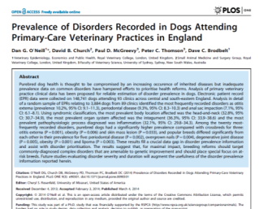
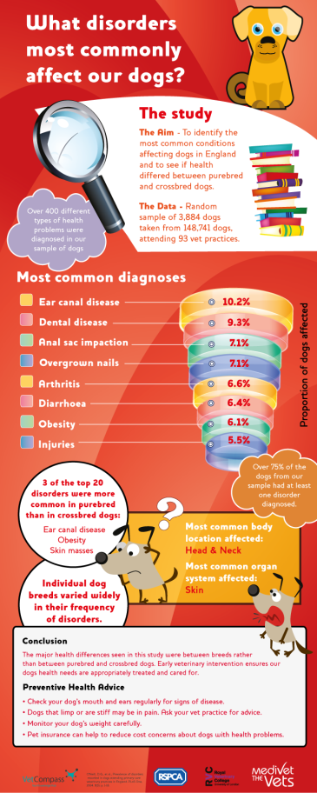
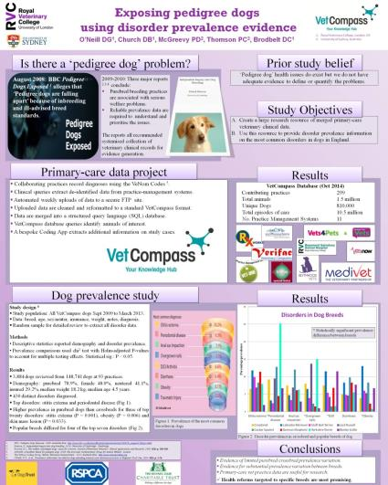

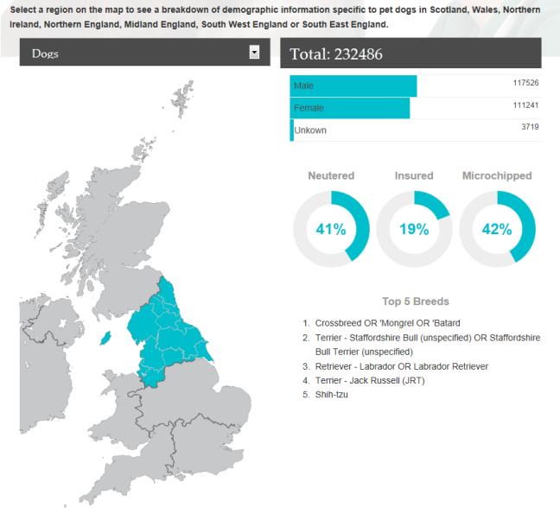

VetCompass Programme
Other stakeholders
Vet practices
Real-time

Slide 15
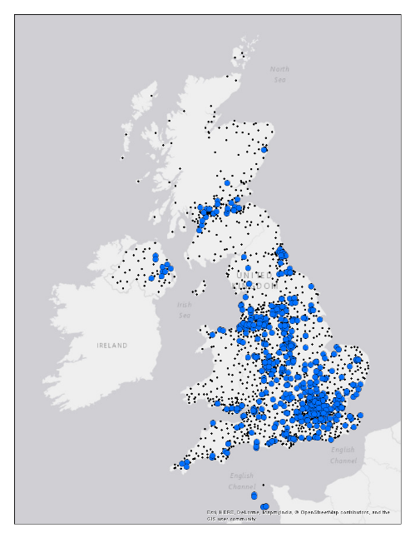
September 2016:
VetCompass: 498 Practices

Slide 16

VetCompass: Sept 2016 status
Participating practices | 498
Unique animals: | 5,843,600
Total episodes of care: | 36,347,778
Total treatments used: | 111,212,641

Slide 17
VetCompass: Sept 2016 status
Canine | 2,764,825
Feline | 1,859,095
Rabbit | 426,679
Guinea Pig | 66,750
Bird | 64,007
Exotic | 21,948
Reptile | 13,756
Equine | 11,337
Unassigned yet | 615,203

Slide 18
Data shared: VetCompass
Identifier | Demographic | Clinical
Vet Group ID | Species | Date of care
Clinic ID | Breed | Clinical notes
Vet ID | Sex | Temperature
Owner ID | Neutered | Reason for visit
Animal ID | Date of birth | Presenting sign
Visit ID | Colour | VeNom diagnosis
Microchip number | Weight | Treatment
Partial postcode | Insured | Discharge status
 | Deceased date

Slide 19

VetCompass Support & Impact
Stated Support:
BVA
BSAVA
SPVS
RSPCA
PDSA
Dogs Trust
The Kennel Club
iCatCare
GCCF
APGAW
International Partnership for Dogs
Dog Advisory Council
UFAW
Eurogroup for Animals
Approval:
RCVS
RVC Ethics
Data Protection Act

Slide 20
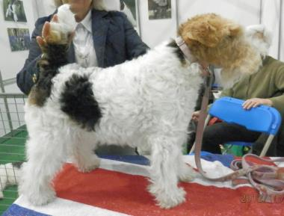
Research Collaboration
University projects:
RVC
Cambridge
Lincoln
Edinburgh
Sussex
Newcastle
Aberdeen
Bristol
Veterinary groups:
Medivet
Vets4Pets/ Companion Care
Vets Now
PDSA
DogsTrust
Multiple independent practices

Slide 21
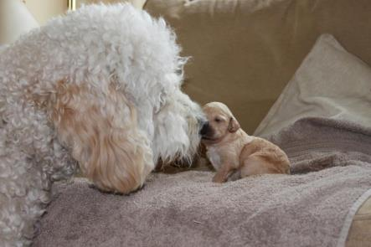
VetCompass –
International extension
Australia
New Zealand
Spain
Germany
US
Sweden
Denmark

Slide 22
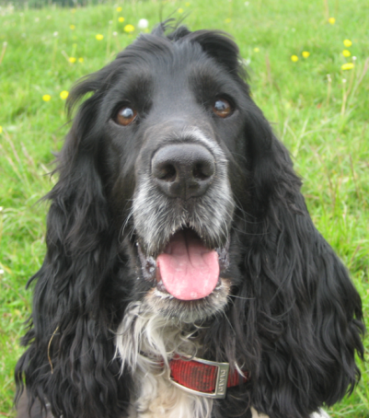
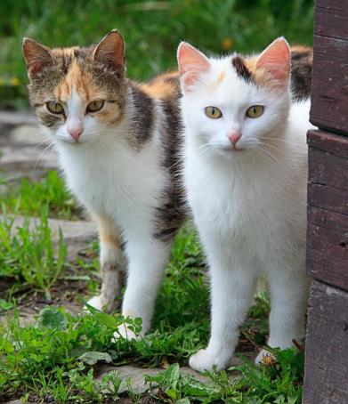

Peer-reviewed publications
Specific disorders
Dogs
Epilepsy
Pyoderma
Chronic kidney disease
Diabetes mellitus
Mitral valve disease – 1
Mitral valve disease - 2
Cruciate disease
Patellar luxation
Mast cell tumours
Patellar luxation
Hyperadrenocorticim
Syringomyelia
Cats
Hyperthyroidism in cats
Diabetes mellitus
General
Disorder prevalence in dogs
Longevity and mortality in dogs
Disorder prevalence in cats
Longevity and mortality in cats
Brachycephaly in dogs
Disorders of CKCSs
Canine health surveillance methods
Disorders of Pugs
Dogs and cats
Glucocorticoid use: cats and dogs
Antimicrobials in cats and dogs
Translational
Aging: dog as model for human

Slide 23
Companion animals – do we really know everything?
      A few simple questions:
        What are the 3 most common disorders of dogs?
        Is the prevalence of common disorders higher in purebred dogs than in crossbred dogs?
        What is the average lifespan of dogs?
        Do crossbred dogs live longer than purebred dogs?
        Do similarly-sized small dogs have the same top disorders?
Ask for the Evidence

Slide 24
Crossbreds vs. Purebreds?
‘Hybrid vigour’ - superior average performance of crossbred progeny of two purebred parents compared with their purebred parents species (Dechow et al., 2007; Nicholas, 2010).
‘Inbreeding depression’ - declining fitness as inbreeding increases (Whitlock et al., 2000; Keller and Waller, 2002).
Production species - viability
- production
- fecundity

Slide 25
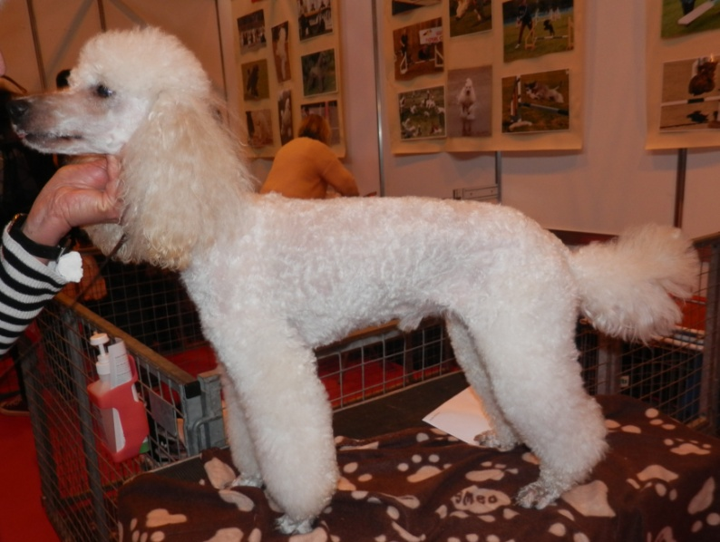
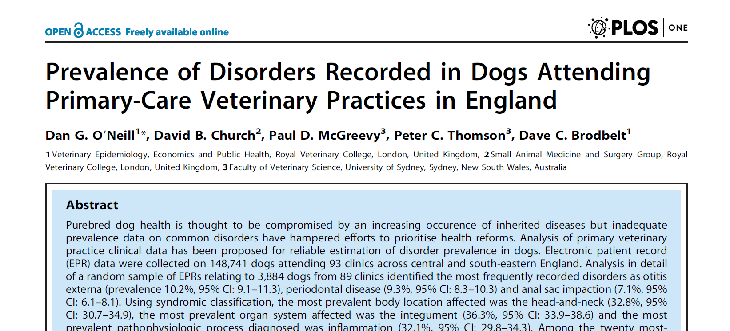
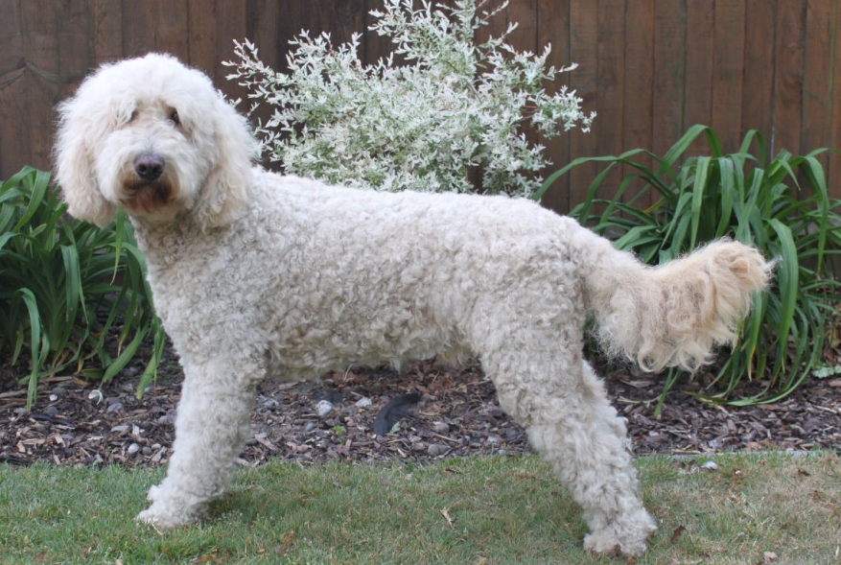

3
Ask for the Evidence
O'Neill, D. G., Church, D. B., McGreevy, P. D., Thomson, P. C. & Brodbelt, D. C. (2014) Prevalence of disorders recorded in dogs attending primary-care veterinary practices in England. PLoS One 9, 1-16
Are Crossbreds healthier than Purebreds?
        What are the most common disorders of dogs?
        Is the prevalence of common disorders higher in purebred dogs than in crossbred dogs?

Slide 26
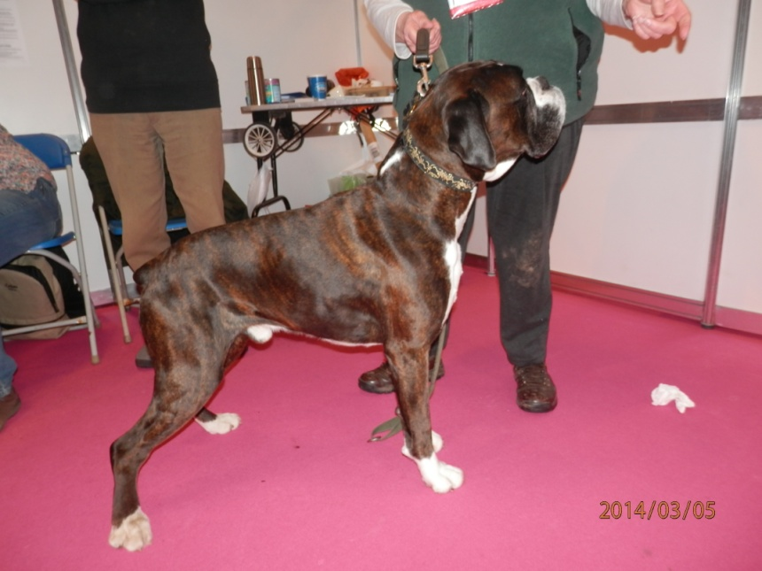
Prevalence of disorders
in dogs
  Methods
  Study population: 148,741 dogs from 93 clinics
  Random sample: 3,884 dogs
  All recorded disorder events extracted
  Results
  430 different disorder types
  8,025 disorder events

Slide 27
Frequent disorders recorded in dogs

Slide 28
Disorders in dogs: Purebred vs Crossbred
*
*
*
* P < 0.05

Slide 29
Does breed matter?

Slide 30
* P < 0.05
*
*
*
*
*

Slide 31
Companion animals – do we really know everything?
      A few simple questions:
        What are the 3 most common disorders of dogs?
        Is the prevalence of common disorders higher in purebred dogs than in crossbred dogs?
        What is the average lifespan of dogs?
        Do crossbred dogs live longer than purebred dogs?
        Do similarly-sized small dogs have the same top disorders?
Ask for the Evidence

Slide 32
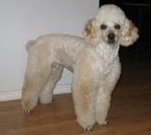
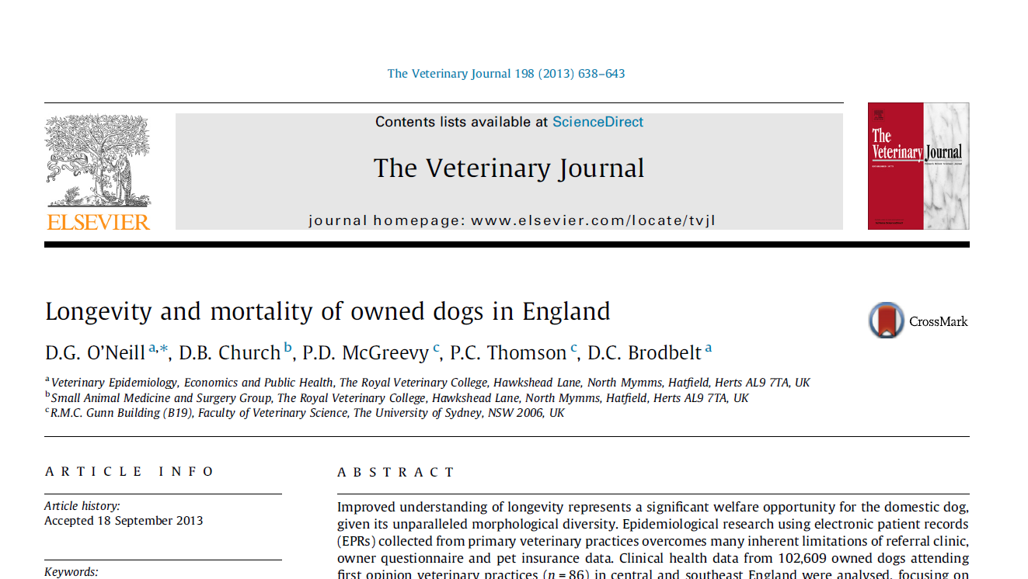
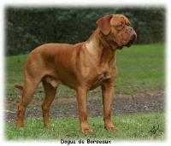
Longevity and mortality of Purebred and Crossbred Dogs
O'Neill DG, Church DB, McGreevy PD, Thomson PC, Brodbelt DC. Longevity and mortality of owned dogs in England. The Veterinary Journal. 2013;198(3):638-43.

Slide 33
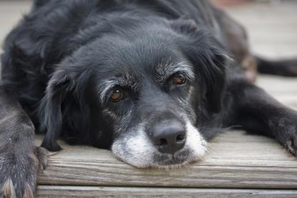
Results
Overall
  86 practices
  102,609 dogs
  5,095 confirmed deaths
  4,153 (86.4%) euthanased
  Median longevity
  Overall: 12.0 years (IQR: 8.9-14.2, range: 0.0-24.0)
  Crossbred: 13.1 years (IQR: 10.1-15.0, range 0.0-22.0)
  Purebred: 11.9 years (IQR: 8.4-14.0, range: 0.0-24.0)
  P < 0.001

Slide 34
Longevity - Does breed matter?
Breed | Median (years) | IQR | No. of dogs
Miniature Poodle | 14.2 | 11.1-15.6 | 20
Bearded Collie | 13.7 | 12.2-14.3 | 25
Border Collie | 13.5 | 11.5-15.0 | 184
Miniature Dachshund | 13.5 | 9.2-14.3 | 25
West Highland White Terrier | 13.5 | 10.4-14.9 | 128
Cairn Terrier | 13.4 | 10.6-15.4 | 27
Jack Russell Terrier | 13.4 | 9.3-15.7 | 298
~~~~~~~~~~~~~~~~~~~~~ | ~~~~~~~~~~~~ | ~~~~~~~~~~~ | ~~~~~~~~~~~
Crossbreed | 13.1 | 10.1-15.0 | 1120
~~~~~~~~~~~~~~~~~~~~~ | ~~~~~~~~~~~~ | ~~~~~~~~~~~ | ~~~~~~~~~~~~
Bulldog | 8.4 | 3.2-11.3 | 26
Rottweiler | 8.0 | 5.5-10.2 | 105
Chihuahua | 7.1 | 1.0-11.9 | 36
Mastiff | 7.1 | 2.01-9.01 | 35
Great Dane | 6.0 | 4.0-9.0 | 23
Dogue de Bordeaux | 5.5 | 3.3-6.1 | 21

Slide 35
Age at Death

Slide 36
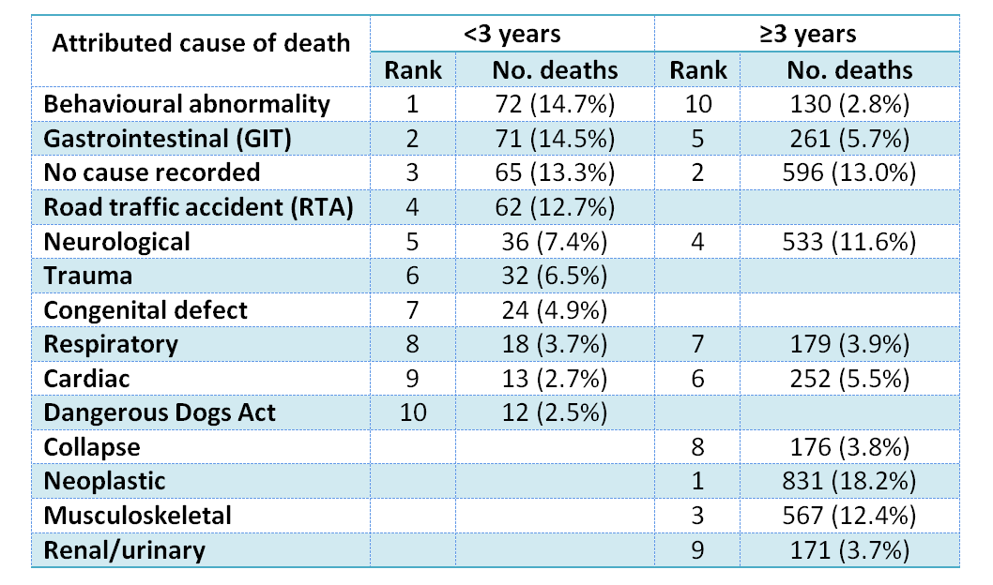
Causes of Mortality

Slide 37
Companion animals – do we really know everything?
      A few simple questions:
        What are the 3 most common disorders of dogs?
        Is the prevalence of common disorders higher in purebred dogs than in crossbred dogs?
        What is the average lifespan of dogs?
        Do crossbred dogs live longer than purebred dogs?
        Do similarly-sized small dogs have the same top disorders?
Ask for the Evidence

Slide 38
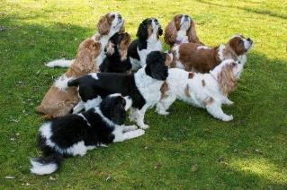
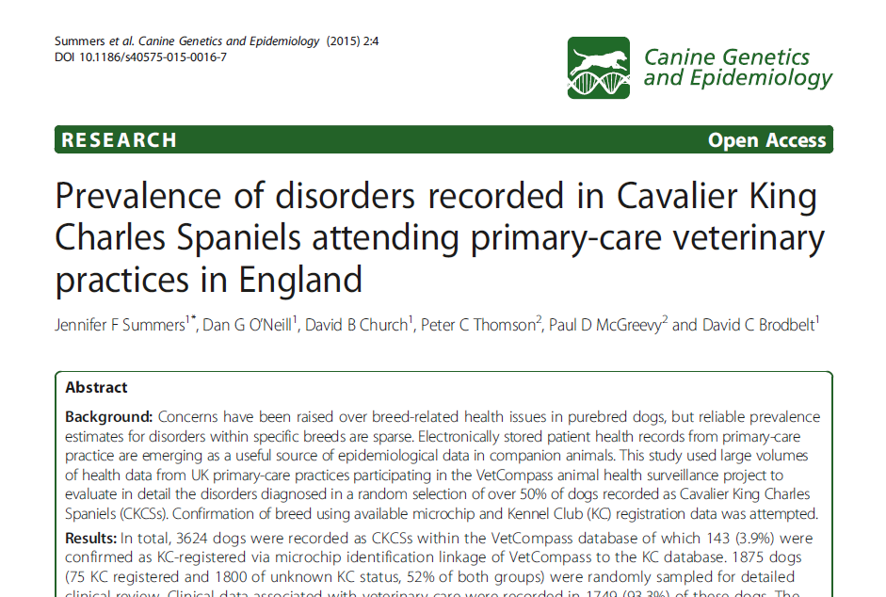
SUMMERS, J., O'NEILL, D., CHURCH, D., THOMSON, P., MCGREEVY, P. & BRODBELT, D. 2015. Prevalence of disorders recorded in Cavalier King Charles Spaniels attending primary-care veterinary practices in England. Canine Genetics and Epidemiology, 2, 4.

Slide 39

Cavalier King Charles Spaniels
      Study population
          3,624 CKCS (Sep 1st, 2009 to July 9th 2013)
          Studied 1,749 dogs (52% random sample)
          Descriptive
          Median adult weight: 10.5 kg
          Median age at last consult: 5.25 years
          Median age at death: 10.5 years
          Method of death: 77.4% by euthanasia

Slide 40
CKCS: Specific disorders (1-15)
Specific diagnosis recorded | Rank | %
Heart murmur | 1 | 30.9
Diarrhoea | 2 | 11.0
Dental disease | 3 | 9.5
Otitis externa | 4 | 9.2
Conjunctivitis | 5 | 7.5
Anal sac infection | 6 | 7.4
Heart disease | 7 | 7.3
Corneal disorder | 8 | 6.5
Periodontal disease | 9 | 5.6
Mitral valve disorder | 10 | 5.0
Umbilical hernia | 11 | 4.1
Flea infestation | 12 | 3.7
Anal sac impaction | 13 | 3.6
Skin mass lesion | 14 | 3.5
Keratoconjunctivitis sicca (Dry Eye) | 15 | 3.5

Slide 41
CKCS: Specific disorders (16-30)
Specific diagnosis recorded | Rank | %
Gastroenteritis | 16 | 3.4
Patellar luxation | 17 | 3.3
Otitis | 18 | 2.7
Osteoarthritis | 19 | 2.6
Colitis | 20 | 2.5
Cataract | 21 | 2.5
Ear mite infestation - Otodectes | 22 | 2.4
Urinary tract infection | 23 | 2.4
Gastritis | 24 | 2.3
Joint disorders | 25 | 2.2
Pyoderma | 26 | 2.1
Enteritis | 27 | 1.9
Pancreatitis | 28 | 1.8
Syringomyelia | 29 | 1.7
Kennel Cough | 30 | 1.7

Slide 42
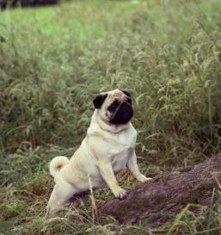
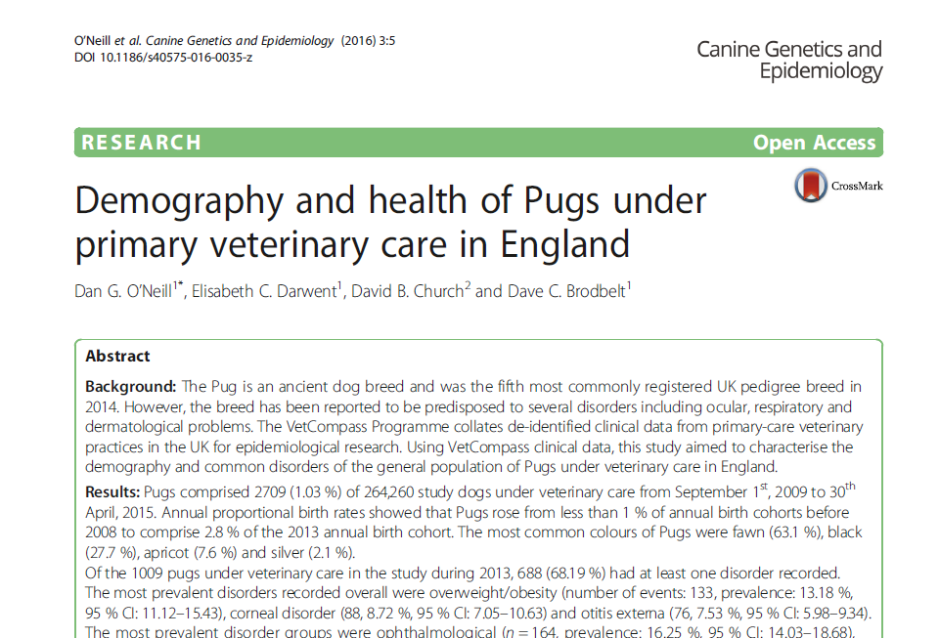
Diane Pearce Collection / The Kennel Club ©
O'NEILL, D. G., DARWENT, E. C., CHURCH, D. B. & BRODBELT, D. C. 2016. Demography and health of Pugs under primary veterinary care in England. Canine Genetics and Epidemiology, 3, 1-12.

Slide 43
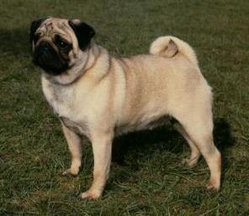
Pugs
      Study population
          1,009 Pugs under vet care during 2013
          Descriptive
          Median adult weight: 9.2kg
          Median age during 2013: 3.0 years
          68.2% had ≥ 1 disorder recorded during 2013
Diane Pearce Collection / The Kennel Club ©

Slide 44
Pugs: Specific disorders (1-12)
Specific diagnosis recorded | Rank | %
Overweight/obesity | 1 | 13.2
Corneal disorder | 2 | 8.7
Otitis externa | 3 | 7.5
Unspecified ear disorder | 4 | 7.4
Anal sac impaction | 5 | 6.5
Periodontal disease | 6 | 6.1
Nails overlong | 7 | 5.7
Brachycephalic obstructive airway syndrome (BOAS) | 8 | 5.2
Vomiting | 9 | 5.0
Diarrhoea | 10 | 3.8
Upper respiratory tract noise increased | 11 | 3.6
Intertrigo | 12 | 3.2

Slide 45
Pugs: Specific disorders (13-24)
Specific diagnosis recorded | Rank | %
Retained deciduous tooth | 13 | 3.1
Umbilical hernia | 14 | 2.8
Respiratory noise increased | 15 | 2.8
Lameness | 16 | 2.4
Ocular discharge | 17 | 2.2
Pruritus | 18 | 2.2
Pyotraumatic dermatitis | 19 | 2.1
Alopecia | 20 | 2.0
Conjunctivitis | 21 | 1.9
Keratoconjunctivitis sicca | 22 | 1.9
Coughing | 23 | 1.8
Pyoderma | 24 | 1.7

Slide 46
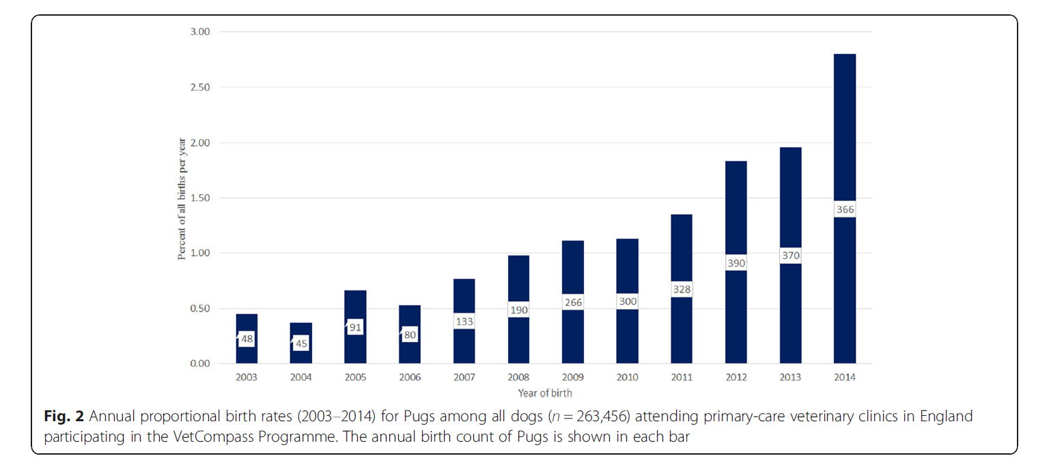
Pugs: Proportional annual birth rates

Slide 47
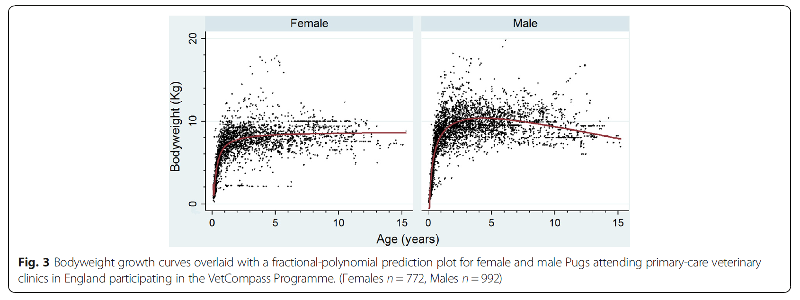
Pugs: Growth curves

Slide 48
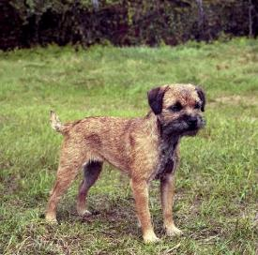
Diane Pearce Collection / The Kennel Club ©
O'NEILL, D. G., DARWENT, E. C., CHURCH, D. B. & BRODBELT, D. C. Border Terriers under primary veterinary care in England: Demography and disorders. In preparation for publication

Slide 49
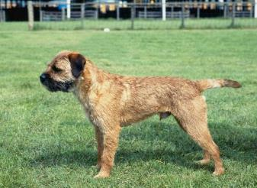
Border Terriers
      Study population
          1,327 Border Terriers under vet care during 2013
          Descriptive
          Median adult weight: 10.1kg
          Median age during 2013: 5.9 years
          Median age at death: 12.7 years
          88.5% of deaths by euthanasia
          66.4% had ≥ 1 disorder recorded during 2013
Diane Pearce Collection / The Kennel Club ©

Slide 50
Border Terriers: Specific disorders (1-12)
Specific diagnosis recorded | Rank | %
Periodontal disease | 1 | 17.6
Obesity | 2 | 7.0
Otitis externa | 3 | 6.7
Nail clip | 4 | 5.3
Anal sac impaction | 5 | 4.8
Vomiting | 6 | 4.4
Conjunctivitis | 7 | 3.3
Diarrhoea | 8 | 3.2
Heart murmur | 9 | 2.6
Lameness | 10 | 2.6
Mass lesion - skin | 11 | 2.5
Pruritus | 12 | 2.5

Slide 51
Border Terriers: Specific disorders (13-25)
Specific diagnosis recorded | Rank | %
Ear disorder | 13 | 2.2
Lethargy | 14 | 2.0
Cataract | 15 | 1.8
Coughing | 16 | 1.8
Seizure disorder | 17 | 1.8
Hypersensitivity skin disorder | 18 | 1.7
Dog bite injury | 19 | 1.6
Epilepsy | 20 | 1.6
Degenerative joint disease | 21 | 1.6
Dermatitis | 22 | 1.4
Gastroenteritis | 23 | 1.4
Infectious canine tracheobronchitis (Kennel Cough) | 24 | 1.4
Pyoderma | 25 | 1.4

Slide 52
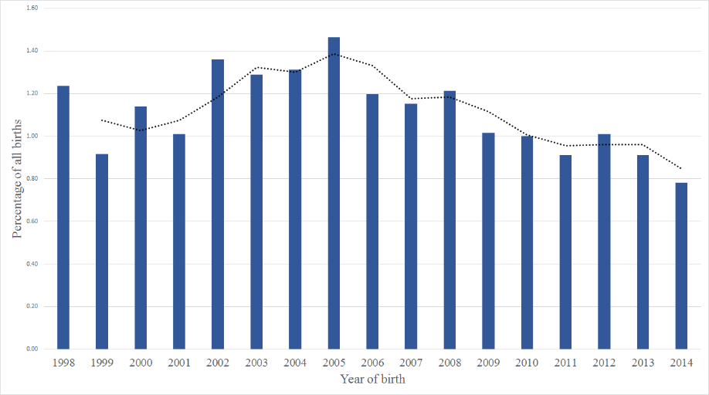
Border Terriers: Proportional annual birth rates

Slide 53
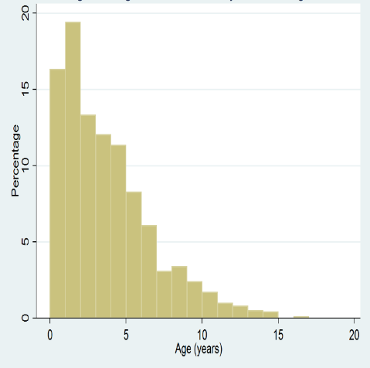
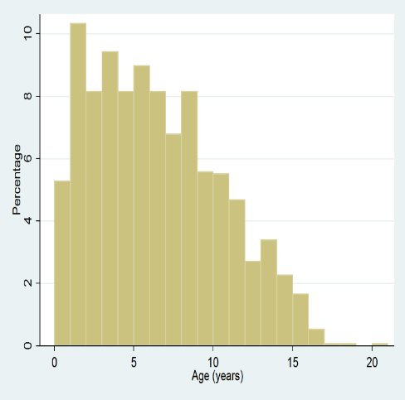
Ages of dogs under veterinary care during 2013
Pugs
Border Terriers

Slide 54
Companion animals – do we really know everything?
      A few simple questions:
        What are the 3 most common disorders of dogs?
          OE, Periodontal, Anal sac impaction
        Is the prevalence of common disorders higher in purebred dogs than in crossbred dogs?
          Limited evidence
        What is the average lifespan of dogs?
          12.0 years
        Do crossbred dogs live longer than purebred dogs?
          Yes: 13.1 yrs vs. 11.9 yrs
        Do similarly-sized small dogs have the same top disorders?
          No. Breed matters.

Slide 55
Key Message:
Base your Belief of the Truth on the Evidence
Ask for the Evidence

Slide 56

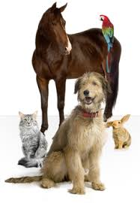







Acknowledgements
RVC VetCompass Team:
Dan O’Neill, Jen Summers, Maddy Mattin, Stephanie Marlow, Emma Buckland, Noel Kennedy, Megan Conroy, Sarah Allen, Kristien Verheyen, Josh Slater, Dave Brodbelt, David Church
USyd VetCompass Team:
Paul McGreevy, Peter Thomson
www.rvc.ac.uk/VetCompass
© ABPC

