Slide 1
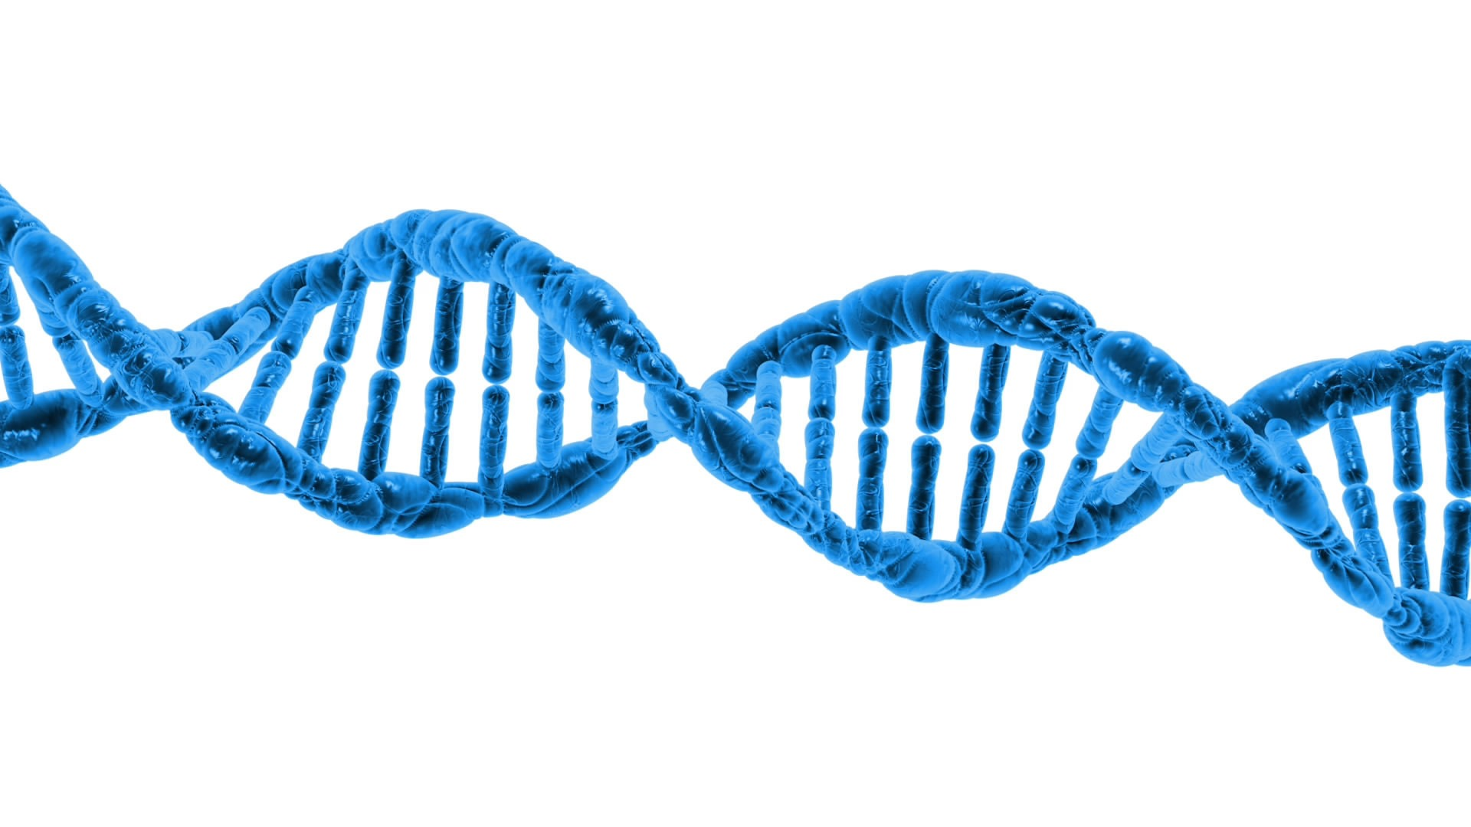

Parentage profiling – supporting robust registration and health schemes
Virtual International Dog Health Meeting #3
Aimee Llewellyn-Zaidi
Project Director for Harmonization of Genetic Testing for Dogs, IPFD
15 March 2023

Slide 2
Parentage Testing and Pedigrees
Pedigrees:
Provided by a registration body
Often self-reported or visual confirmation, sometimes confirmed with parentage testing
Assumed to “confirm” Breed/heritage/etc.
Perceived added value to a dog
Data used for health programs and tools: DNA testing, COI, HC, EBVs…
Parentage Testing:
Compares the genetic profile between potential parents and progeny to determine parentage

Slide 3
Parentage Testing and Pedigrees
Estimates of 1-9% inaccurate parentage; varying by breed
Just a 5% over 6 generations can cause a disease mutation frequency of 0.2
This could have serious consequences for health risks to dogs, and confidence in pedigree registration, and breeding plans

Slide 4

Parentage Testing and Pedigrees
What causes pedigree inaccuracies?
Breeder record errors
Dual sire matings (unintentional/unknown), leading to split-litters
“whoopsies” resulting in breeder record errors
purposeful deception: over-use of a sire or dam, combining separate litters, split-litters, unsanctioned crossbreeding, etc.

Slide 5
Pedigrees – challenges
Risks to Kennel Clubs/Registration bodies:
Reputational damage/trust
Reduced value of pedigrees, breeds
Lawsuits
inaccurate data for health programs
Risks to Health:
Inaccurate data = inaccurate breeding tools and resources
Breeding decisions
Inaccurate dog records/assumed “health”
Risks to Breeders:
Lawsuits
Breeding/health risks

Slide 6
Parentage Profiling
When administered robustly, very accurate parentage affirmation (ISAG 2020 is +99%)
Some panels (the list of pieces of DNA (SNPs usually) used to compare between dogs) can have additional beneficial uses – e.g. solve parentage cases where only one parent is available, some genetic diversity and the heterozygosity (ISAG 2020)

Slide 7
Benefits to Kennel Clubs
Accurate parentage = accurate health data
  All health tools and health records are built on the assumption that the dog is who it claims to be, with associated relatives
  Monitoring of genetic diversity, breed health risks, breed health improvement all require accurate recording of familial relationships
Reduce risk of reputational damage/lawsuits
Accurate parentage, by implication, also affirms “breed” and improves trust and value in a pedigree
It’s likely coming anyway…

Slide 8
Benefits to Breeders
Accurate parentage = accurate health data
Accurate parentage = accurate breeding records
Improved trust/reassurance in breeding plans and stud or bitch usage – no ‘secrets’
Value to puppy buyers

Slide 9
Challenges
There will be inaccuracies in records
  Grace or catch-up period
  ‘amnesty’ for inaccurate pedigrees, and corrections
  Retro-fitting or switching to new parentage panels
Costs
  Breeder/owner, testing
  KC/registration body, data systems and management
Choosing a provider/panel
  ISAG
  AKC
  Other?
Education, and policy changes

Slide 10
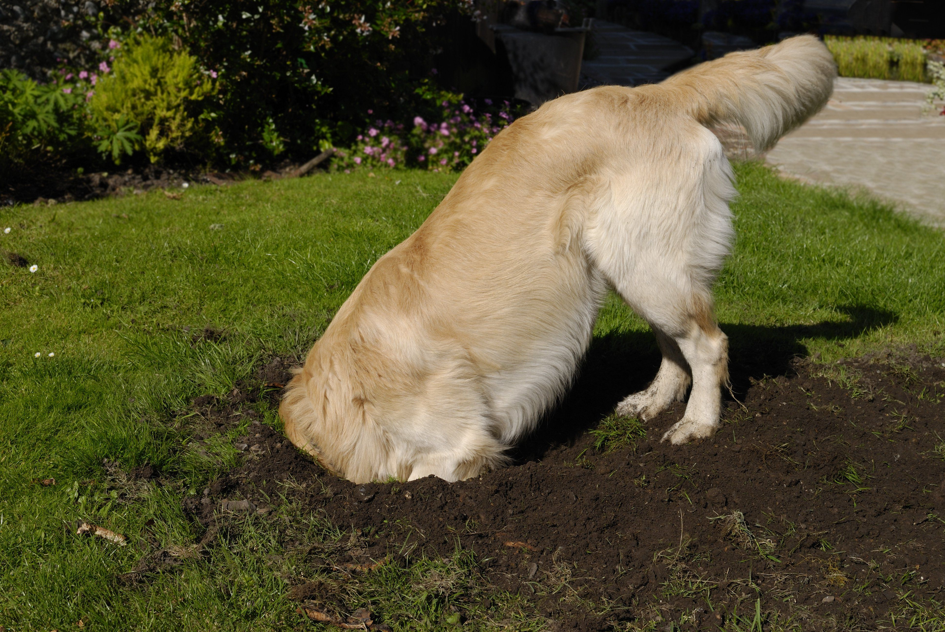
But parentage profiling for all or most dogs is likely going to happen, so get ready!

Slide 11
References
Lewis, T.W. The impact of incorrectly recorded parentage on inferred genotypes over multiple generations. Canine Genet Epidemiol 6, 6 (2019). https://doi.org/10.1186/s40575-019-0074-3

Slide 12


We Appreciate Your Support!
IPFD’s Virtual Meetings are typically offered free to all participants, but we ask you to please consider making a donation to IPFD and/or the Harmonization of Genetic Testing for Dogs specifically.
< You can scan here with your phone
to make a donation now at DogWellNet.com.

