Slide 1
Big Data Breakout Group
Kari Ekenstedt, DVM, PhD – Theme Leader
15 June 2024

Slide 2
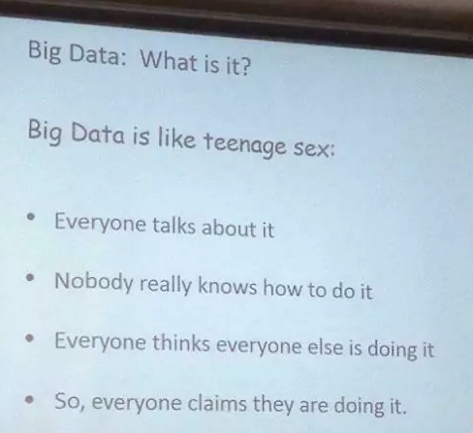
Big Data

Slide 3
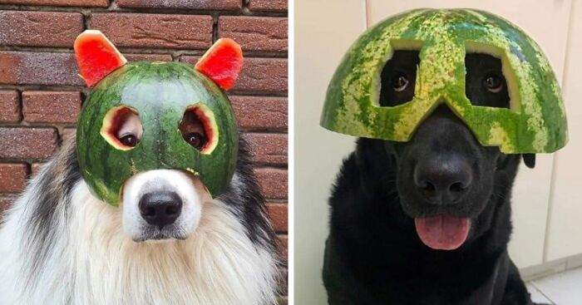
Big Data has some Big Problems
Could have had multiple sub-groups on specific issues/topics
Challenges
Existing solutions
Shaky first steps
Actionable ideas

Slide 4
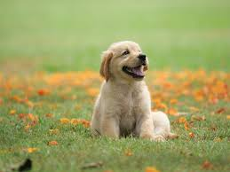

Challenges for Big Data
Mechanical: Data Storage, Data Transfer, Data Analysis
How to get Big Data into a format breeders/the public can use and benefit from
How KCs can use Big Data
Notes:
Commercial GTPs had infrastructure from the get-go. KCs have wildly different resources/starting points.

Slide 5
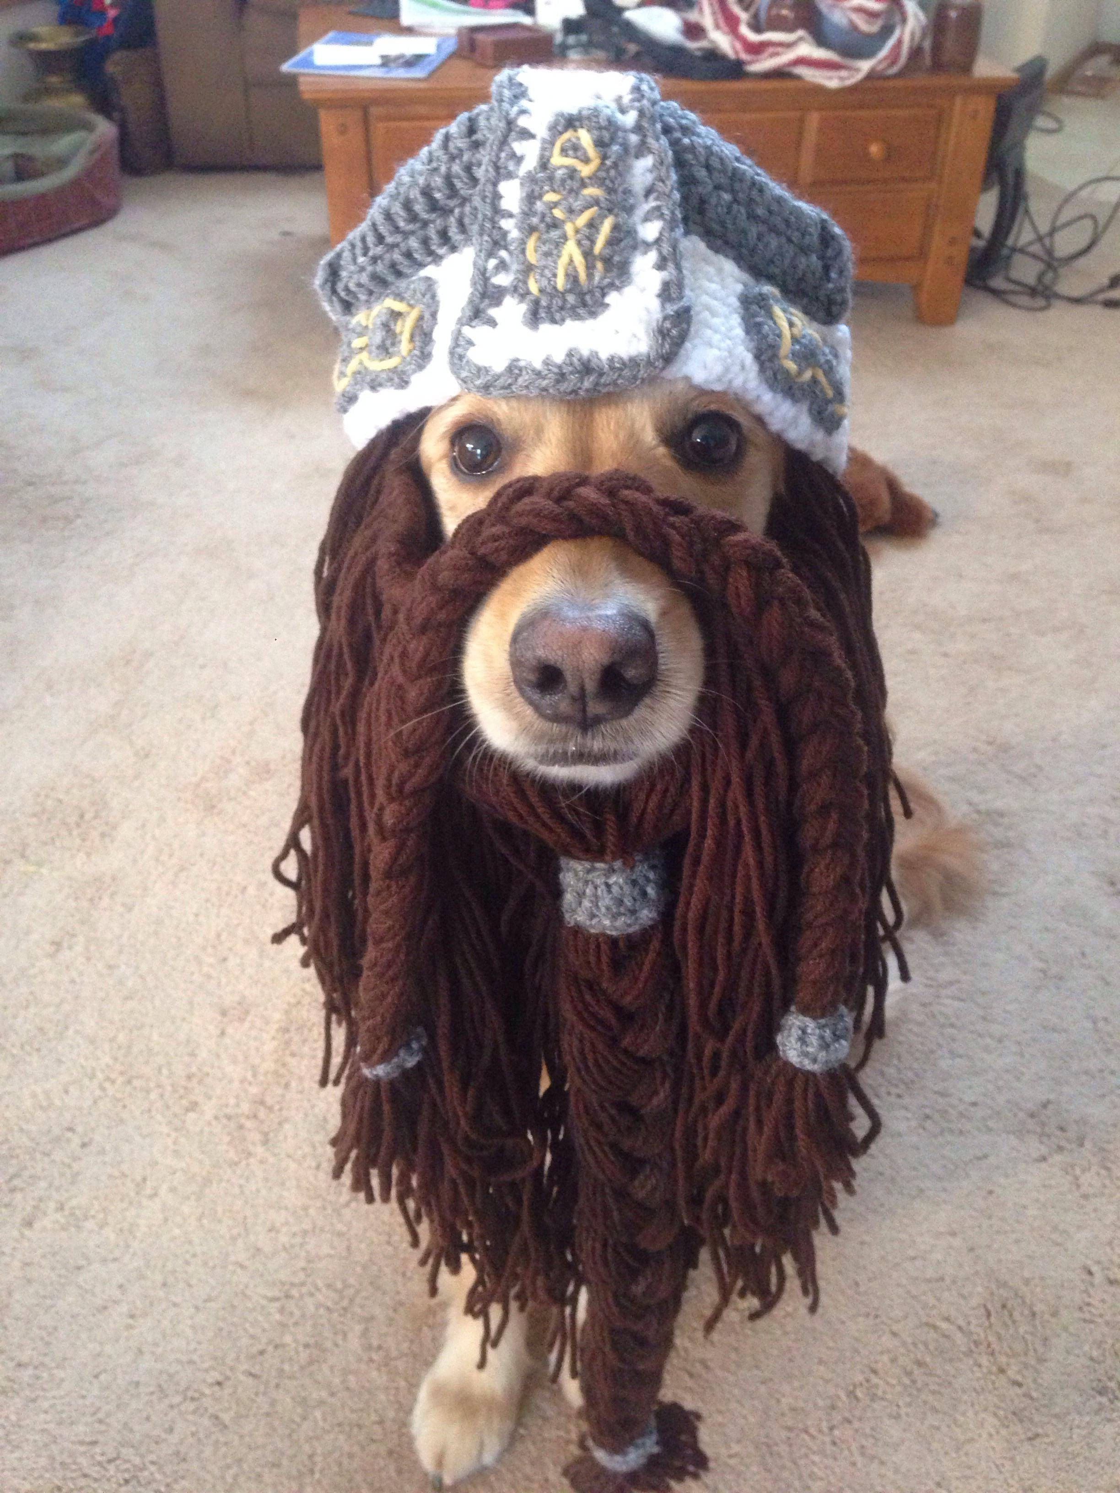
Challenges for Big Data
Integration of genomic data with clinical data/phenotypes
  Who is providing the phenotypes?
  Is the phenotype data update-able?
Which variables need to be built into the model as covariates or fixed effects?
  Example: Correction when using different methods for hip rads to assess dysplasia
Notes:
Owner-supplied phenotypes versus GP veterinary supplied phenotypes versus veterinary specialist supplied phenotypes.
Citizen science projects like Darwin’s Ark. How to get phenotypes continuously updated as well?
Accuracy of phenotypes (need dxes from specialists) needed is high for breeding tools, but owner-provided data (while potentially more sketchy) can be very valuable.

Slide 6
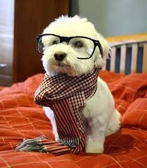
Challenges for Big Data
Lack of standardization
  Diagnostic codes
  Identity of dogs
  Data formatting
Protection of human-associated data (identification, address, etc.)
  EU GDPR (General Data Protection Regulation)
Consent
  Consent for breed tool is not necessarily permission to use that data for research (and vice versa)
Money
Notes:
Ways to keep identify private but keeping phenotype data (big data is mostly useless without accurate phenotypes)

Slide 7
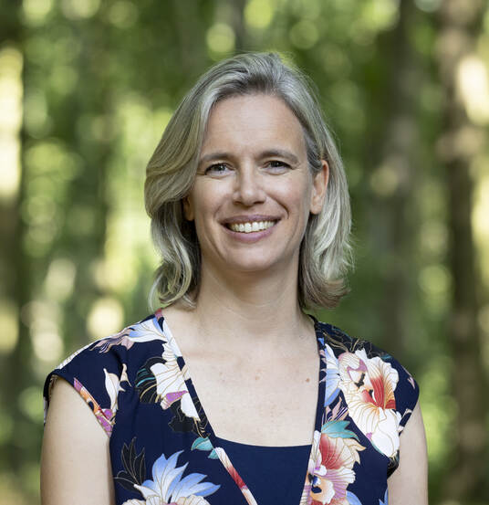
Let’s Not Reinvent the Wheel
We are all a bit jealous of the Netherlands where:
  All registered puppies also get their genome-wide SNP data generated
  This is connected/combined with clinical data
OFA: Breed Health Surveys
  Templates, customizable
  Freely available
  Anonymized and not updateable

Slide 8
Next Steps Not 100% Clear
Education of breeders/the public
  Genetic tests are not unequivocal destiny
  Turn complex Big Data into facts
    Example: 1% increase in IBC equals average 8 less days of life for your dog
  Teaching them what the heterozygosity measures they are now getting actually mean and how to use them (one piece in big puzzle)
Start with a small pilot project with specific goal(s)
  Project would utilize Big Data
  Possibly use a breed small in numbers where the gene flow is much more global
International ID problem: cattle, horses are more standardized. Is this doable with dogs?
Use of machine learning for gleaning helpful data from some of the free-form fields (for example in VetCompass)

Slide 9
Specific/Actionable Idea #1
Webpage maintained on IPFD which collects (and annotates) scientific papers on specific topics
  Provide a lay summary paragraph
  Example: Proof that science does support EBVs as a useful breeding tool
    EBVs in dogs are…not perfect
  Can point breeders here so it’s not just “my word” – here is the collected scientific proof
(What about GBVs? Takes time to assemble/collect this data, and if breeders do not trust or use EBVs, then why spend the $$ on GBVs?)
Notes:
EBVs probably being used most successfully in dogs right now in the working dog groups (like guide dogs/assistance dogs)

Slide 10
Specific/Actionable Idea #2
Another webpage, hosted by IPFD, similar to the GTP list
List of the “BIG” datasets that various stakeholders currently/already have
  Example: UK KC has phenotype info on hips, eyes, elbows
  Genetic testing (without a long list) – genome-wide data (like SNP data) and/or single-gene diseases and traits
  What datasets are associated with the GRLS?
  Does this data have geographic information attached?
Of interest to owners, breeders, researchers, and others in the Big Data field
Email Aims with updates (like you already do for GTPs)
If this happens before next AKC CHF (August 2025), someone could present this to all the national/parent breed club

Slide 11
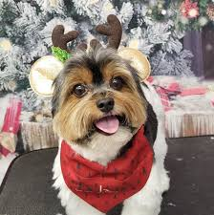
Specific/Actionable Ideas #3 and #4
Could IPFD provide a template consent form?
  Not just for this immediate DNA collection, but for all future research
Create an EBV Working Group

Slide 12
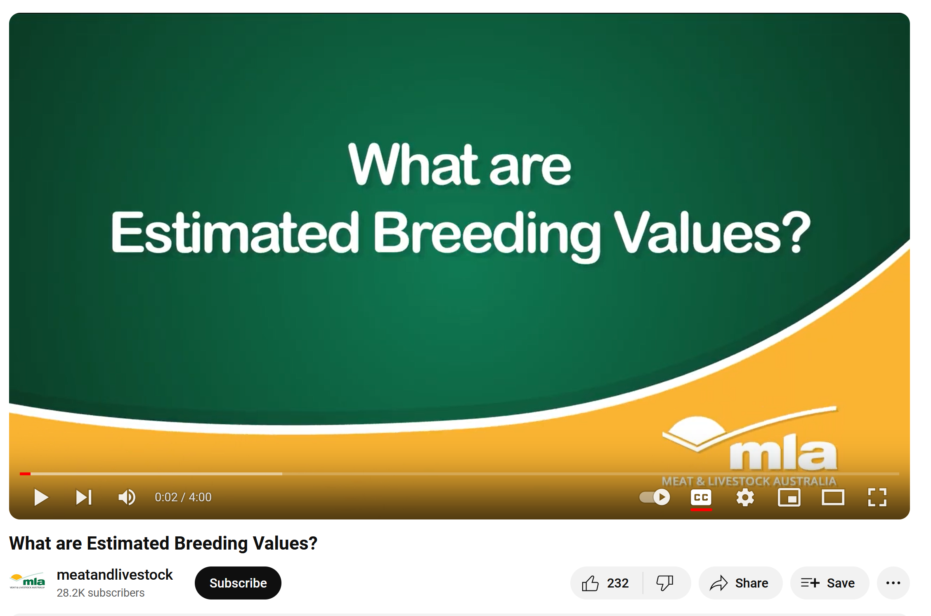
Estimated Breeding Value Working Group
Similar idea to brachycephalic working group (out of Windsor conference)
Members: Joanna Ilska, Sofia Malm, Jerry Bell, Someone from Mars but not Jonas Donner (Casey Knox!), Riitta Kempe, and Eddie Dzuik
Charge: Explore how EBVs are used
currently in dogs, how they could
more effectively be used, how to
educate breeders on EBVs (short
videos?)

Slide 13
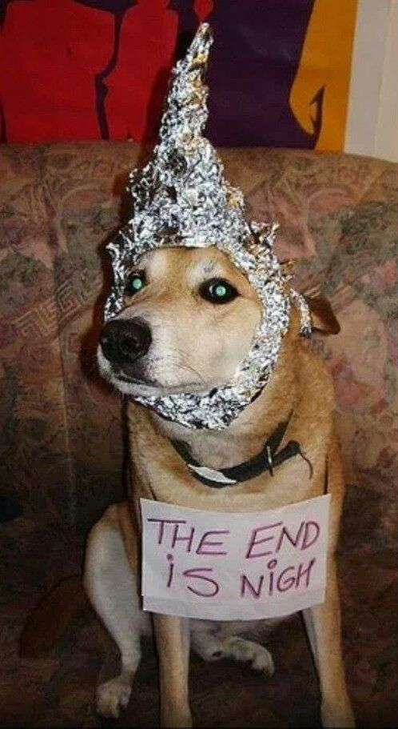
The End

