Slide 1
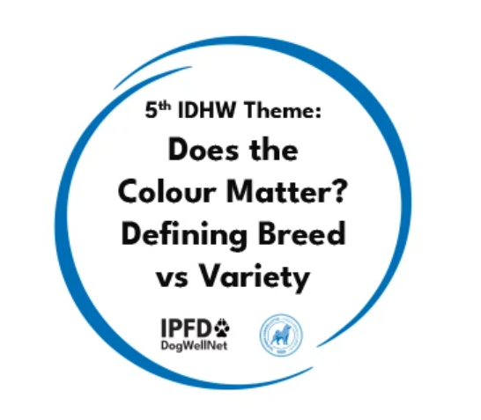
Breakout session #4
Does the Colour Matter? Defining Breed vs Variety
5th IPFD International Dog Health Workshop
Helsinki, Finland.

Slide 2
People:
Scientist, breeding advisors, breeders, vets, historians, Kennel club breeding board members and
leaders, people working in animal protection services
Open discussion about the topic:
What makes cross breeding hard to do?
What are the pros and cons owning a cross breed, why would anyone buy one?
There needs to be a clear distinction between cross breeding vs. designer breeds
One needs to realize that genetic diversity is not solved instantly with one or two crossbred litters.
Crossbreeding requires a consensus from the country of origin, but UK for example does not have policy for these.
Collaboration between countries is needed but the policies between countries vary.
How to determine your selection criteria?
The definitions of varieties are different between countries
What is the purpose of different definitions variety vs. breed, could all the varieties of a given breed be considered as one breed. How are the varieties defined. This boils down to club policies. FCI allows crossbreeding between varieties, but the clubs may have different rules
Communication is needed
How to change peoples perception about cross breeds, why do we think of breeds as we do. Even though cross breeding was allowed, does not automatically mean that every breeder would do it for every litter.
When talking about preservation, one must remember that are you trying to preserve the breed or preserve what you got! In reality, there is always a there is always a drift of some kind as people are the ones making the breeding decisions.
We need more publications and discussion about historical facts about the breeds and breeding rules, what was considered good/responsible breeding.

Slide 3

Communication and Education
We need to promote open minds by:
Educating breeders and breed clubs about the history of dog breeding
Write easy to read articles about crossbreeding how, when, why to the breed club gazettes
Webinars about the crossbreeding experiences - what to do and what not
Educating show judges
We need to clearly state that we are improving the breed, NOT making new designer breeds
Action:
Webinar about history of breeding made available worldwide through DogWellNet.

Slide 4
Policies + Procedures
International differences in the rules and who decides the rules regarding crossbreeding and how breeds and breed varieties are defined
Action:
Moving towards harmonization of crossbreeding rules.
Barbara Thiel will send a questionnaire to representatives from France, Italy, UK, Germany, Denmark, Finland, Norway, Sweden and USA about the crossbreeding rules those countries have. She will also sum up all the information to DogWellNet.
Once the rules are summarized, the 6th IDHW can recommend a harmonization scheme

Slide 5
Generic action plan – How to Crossbreed
Where to start ?
Adapted from Swedish KC
1. Map the situation you are in
2. Define your goal – increase the diversity or discard a disease or both
3. Think how to proceed. Is breeding possible from outside the registered population? Start a crossbreeding project? Open the studbooks for specific breeds with given rules? All of the above?
4. If going ahead with the cross breeding, decide on the breed. Take to account that the appearance in itself is not the main issue, but you have to think about the character and the intended use of the dogs (hunting, herding, companion etc.)
5. Start cooperation with the breed clubs used for crosses
6. Define the thresholds for crossings
7. If crossbreeding, decide how many F1 litters you will breed
8. Plan how to evaluate puppies – in health and in character
9. Plan a timeline
Action:
DogWellNet will publish an English version

Slide 6
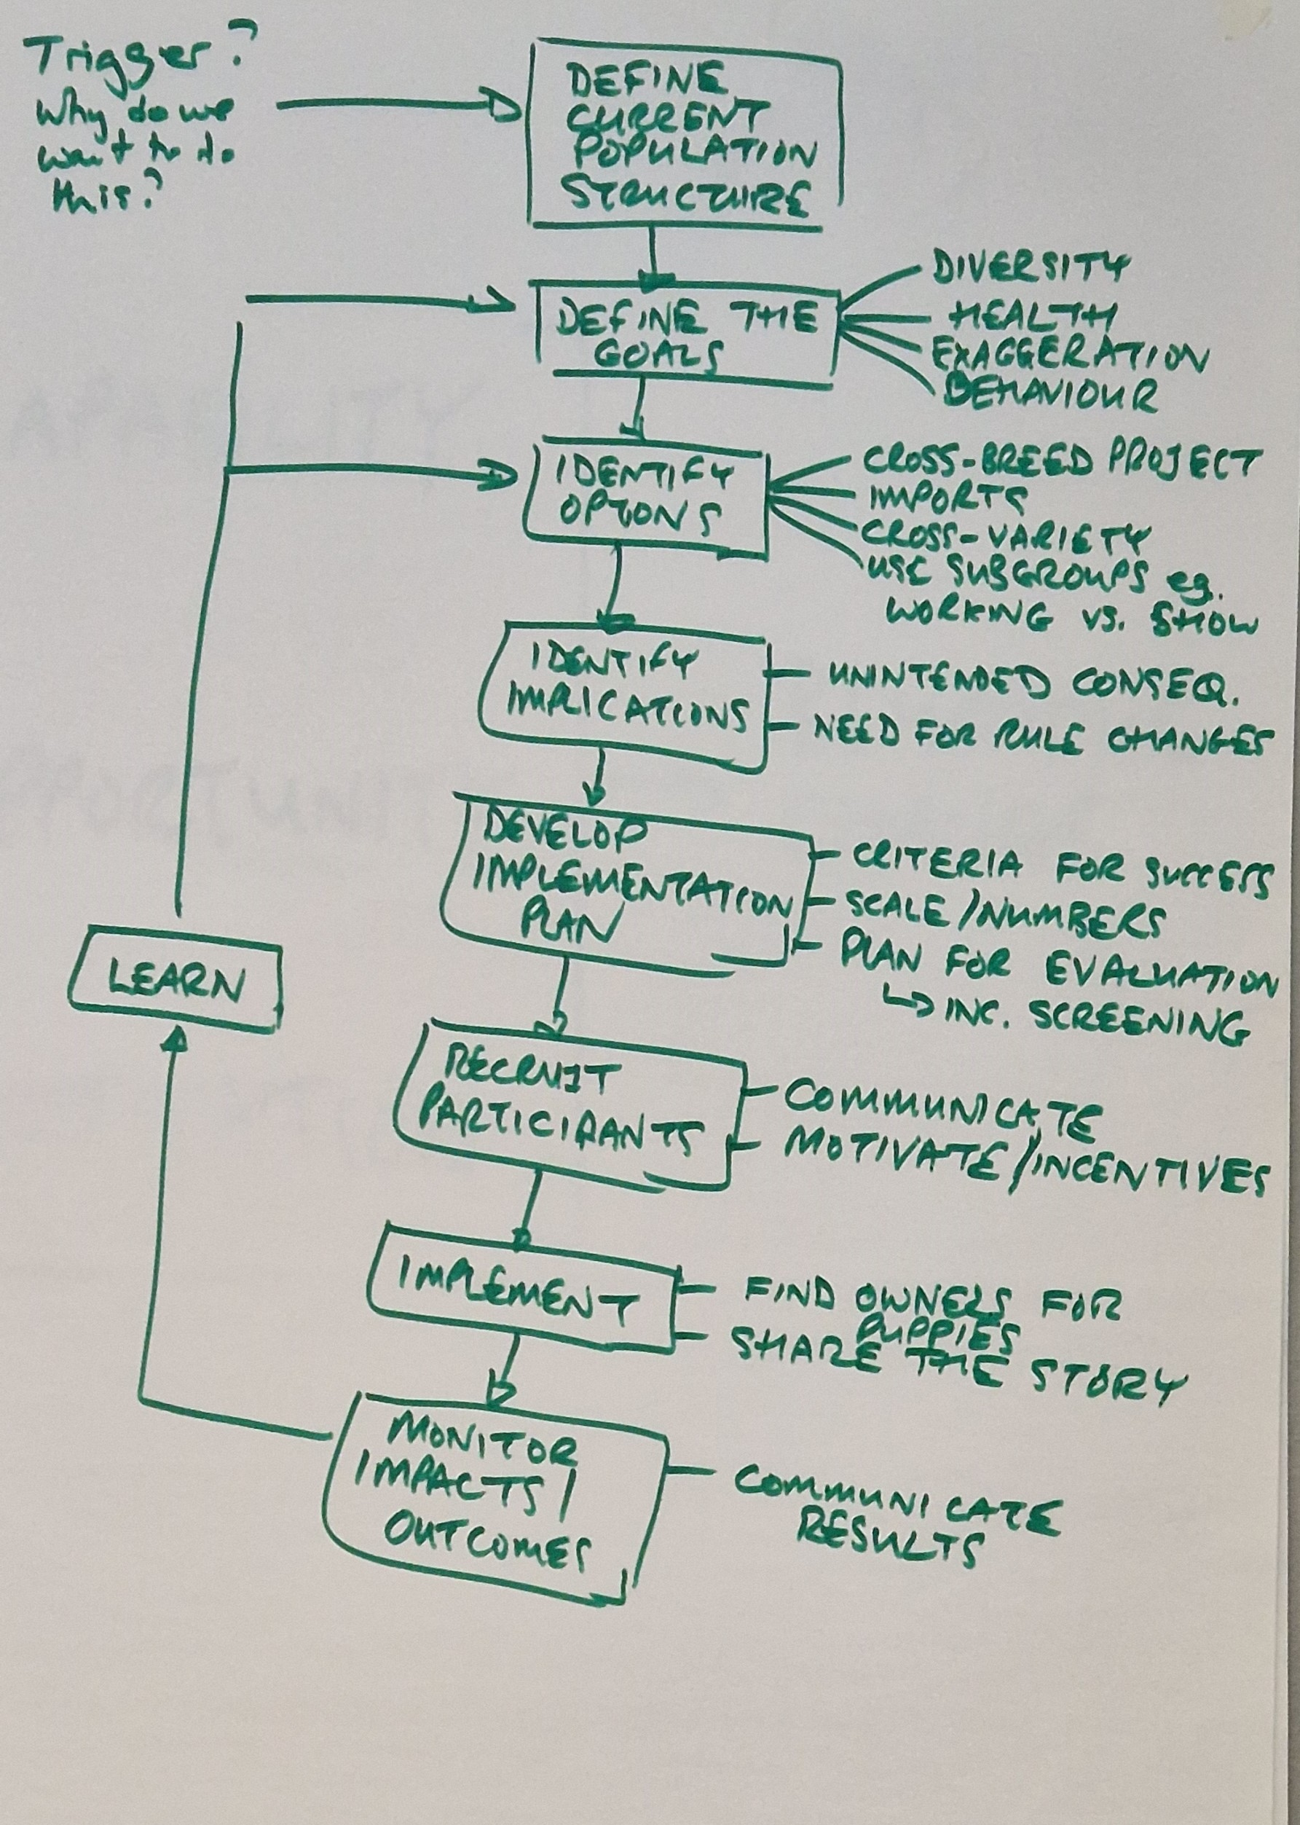

Slide 7
Incentives
Recognition of the crossbred individuals
Possibility to be involved in all the same activities than the “pure breds”
Enforce the idea of “Keep the breed” – do it before it is forced to do by authorities
Mind set of the breeders and the support from the Kennel Club is crucial.
Action:
Get attention!
UK KC will explore the possibility of International Cross Breed projects of the year display in Crufts and
Could International Canine Health reward for a crossbreeding project be applied.

